Slide 1

Slide 1
Analysis of Youtube Songs Data
Insights into Song Performance, Popularity, and User Engagement
Presenter: Mariam Fatima

Slide 2
Slide 2
INTRODUCTION
Content:
This presentation covers an analysis of YouTube songs data.
The goal is to provide insights into song performance, popularity, and user engagement.
Visualizations and reports were created using Power BI.
2

Slide 3
Slide 3
DATASET OVERVIEW
The dataset includes attributes such as video ID, channel title, title, description, tags, published date, view count, like count, favorite count, comment count, video duration, video definition, and caption details.
The data was cleaned and preprocessed to ensure accuracy.
3

Slide 4
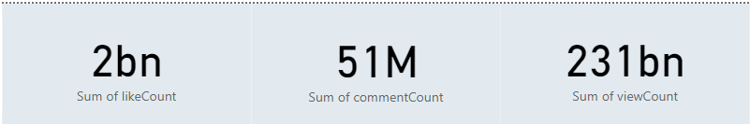
Slide 4
KEY METRICS
TOTAL VIEWS
TOTAL LIKES
TOTAL COMMENTS
4

Slide 5
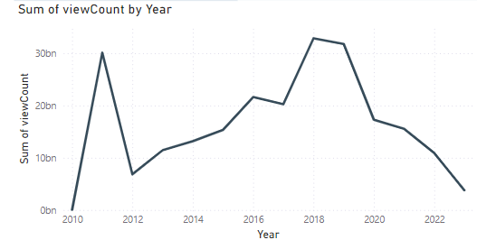
Slide 5
VIEWS OVER TIME
The trend of views over time shows significant spikes and drops.
5

Slide 6
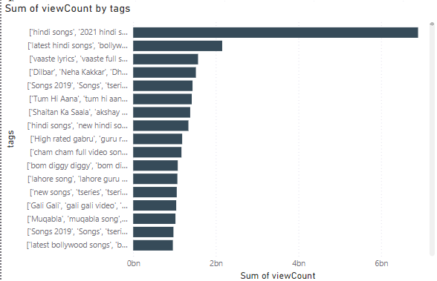
Slide 6
TOP TAGS BY VIEW COUNT
Popular tags significantly contribute to higher view counts.
6

Slide 7

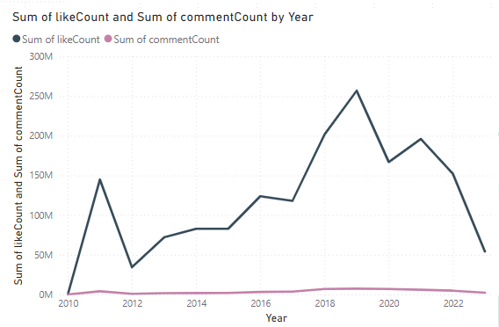
Slide 7
Engagement Metrics by Year
Analysis of likes and comments over the years.
Your logo

Slide 8
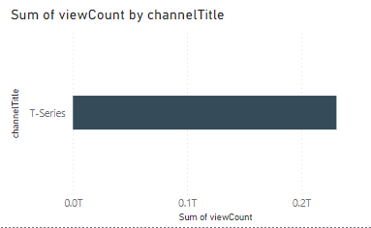
Slide 8
CHANNEL PERFORMANCE
Highlighting the performance of top channels.
8

Slide 9
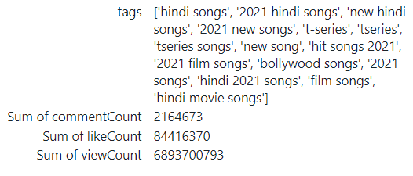
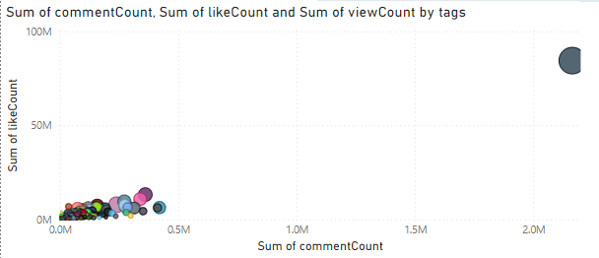
Slide 9
LIKES VS COMMENTS BY TAGS
9

Slide 10
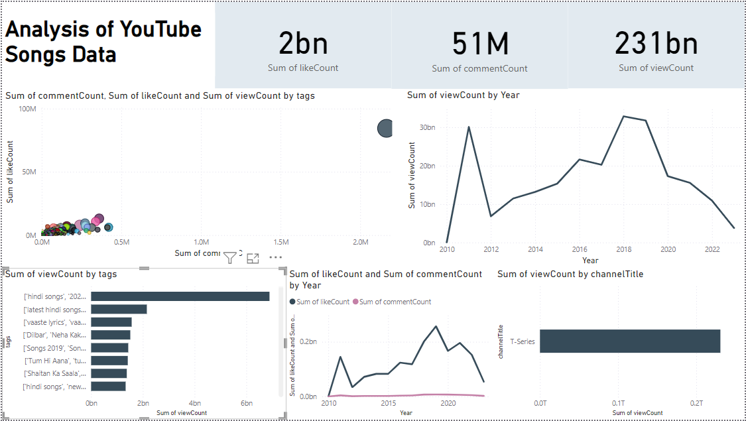
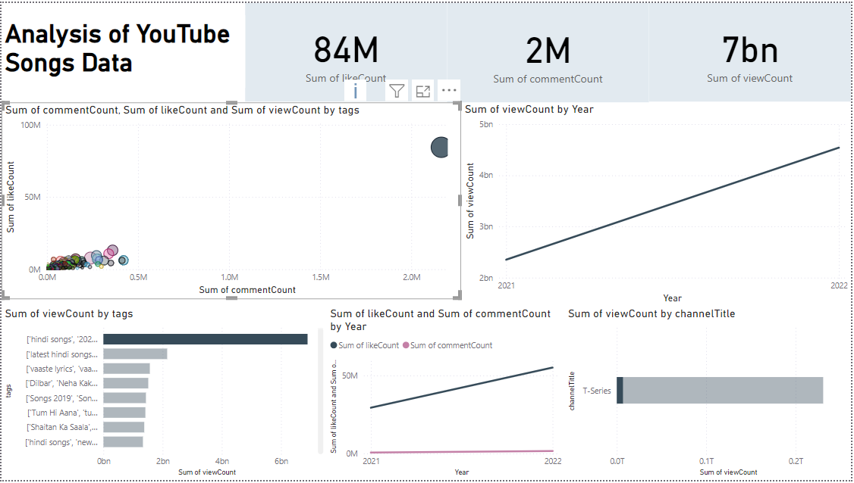
Slide 10
CONCLUSION AND RECOMMENDATIONS
The analysis provides valuable insights into YouTube song performance and user engagement.
Recommendations for content creators:
Focus on popular tags to increase views.
Publish content during peak times to maximize engagement.
Enhance video quality and caption availability to attract more viewers.
10

Slide 11

Slide 11
THANK YOU
CONNECT WITH ME: mariamffatima GITHUB: mariamffatima/Mentorness/tree/Project-2

